Slide 1
Assignment deadlines reminder
March 31st – web service programming tutorial (10%)
Other assignments deadlines preview
15% - Hot topic study journal – 3 tasks
Task 1 – March 26th
Task 2 – April 2nd
Task 3 – April 9th
10% - Exercises - Case study – April 16th

Slide 2
COMP3017 Service Computing

Slide 3
Service composition in Pervasive Computing Environments
J. Siebert, J. Cao, Y. Lai, P. Guo, and W. Zhu, “LASEC: A localized approach to service composition in pervasive computing environments,” IEEE Transactions on Parallel and Distributed Systems, vol. PP, no. 99, 2014

Slide 4
Service composition
Service: A functionality of a computational entity whose execution satisfies the requestor’s requirement.
Service Composition: A process of identifying and combining component functionalities to compose a higher level functionality and provide means to perform the requested functionality.

Slide 5
Pervasive computing environments

Slide 6
Challenges in large scale dynamic environments
Bottom-up devices collaboration support
Handling changes in environments
Heterogeneity support

Slide 7
Service composition framework

Slide 8
Service composition approaches

Slide 9
Localized approach

Slide 10
Localized approach example
Service request
Valid solutions

Slide 11
Basic idea of LASEC algorithm

Slide 12
Overview of the Solution (1)
Requirements for new solution
There should be no special entity to manage service composition process
Service providers can communicate only with their local neighbours, not all other service providers
No service provider knows the full global information or gathers it
Initially, service providers are atomic, in sense that they provide some functionality and are not coupled with any other service provider to provide a composed service

Slide 13
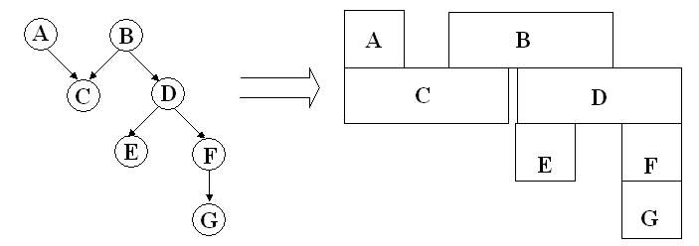
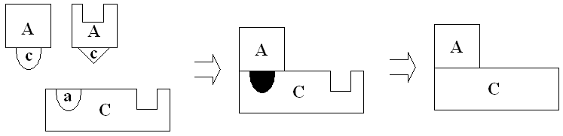
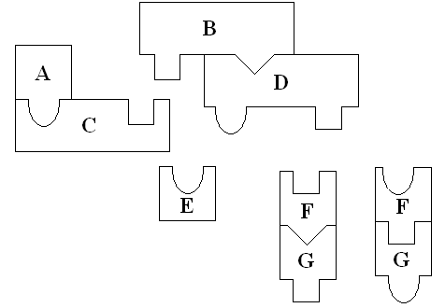
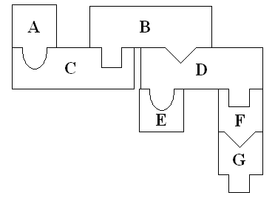
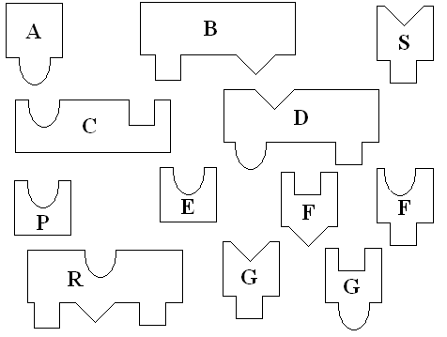
Overview of the Solution (2)
Inspired by the strategies adopted in solving jigsaw puzzles.
Forming service sections: Service provider identifies what service type it needs to interlock with through his output and then searches for appropriate service provider with matching input type.
Growing service: At later stages these sections are joined together with other sections to gradually construct the completed solution.

Slide 14
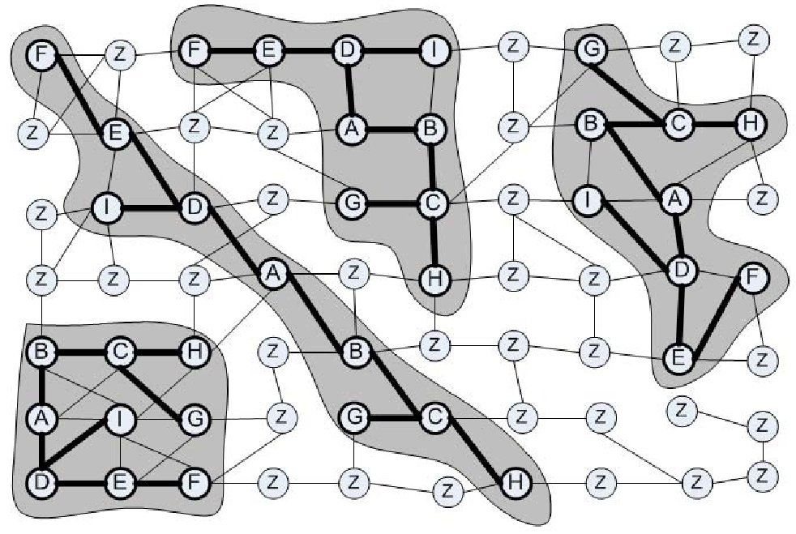
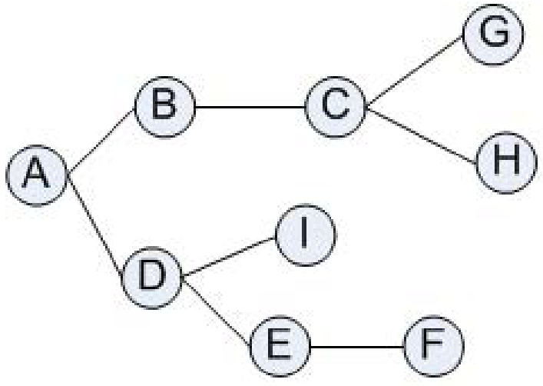
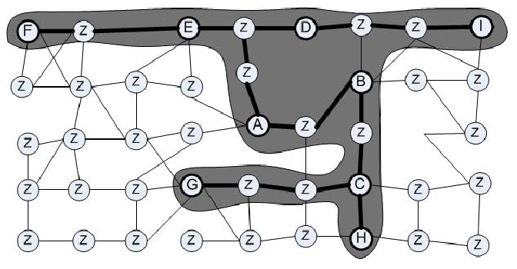
Overview of the Solution (3)

Slide 15
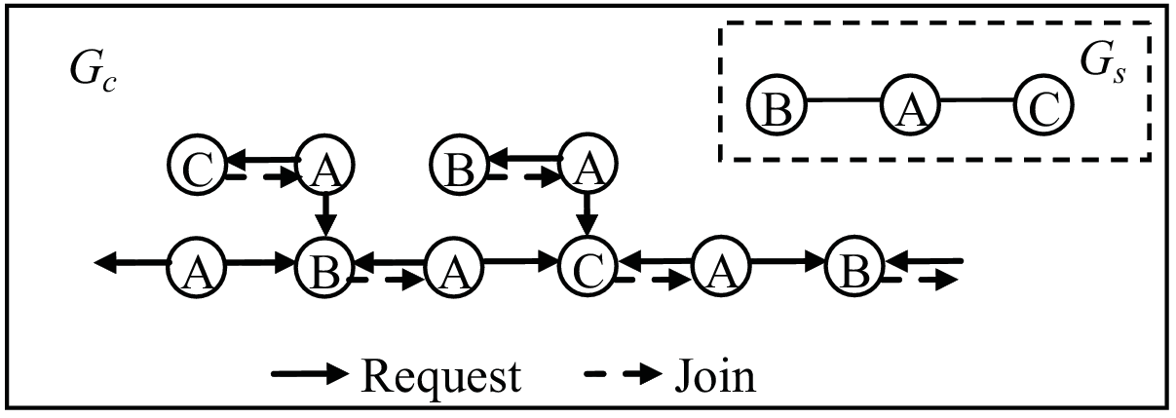
Challenging Issues
Awareness
How does a node know the current members of the section that it has participated in? How does a node know the section that it has participated in has already failed?
Judgment
How does a node know which section is more possible to succeed in the composition when the node is required to join? How to reduce or stop the useless composition which cannot be completed?
Assembly
Since there is no coordinator in the network, how to guarantee the composition to converge into one integrated overlay graph.
How to constraint the blind and random composition among the UIOs that could not form the requested service so as to guarantee all the services specified in the request will be provided

Slide 16
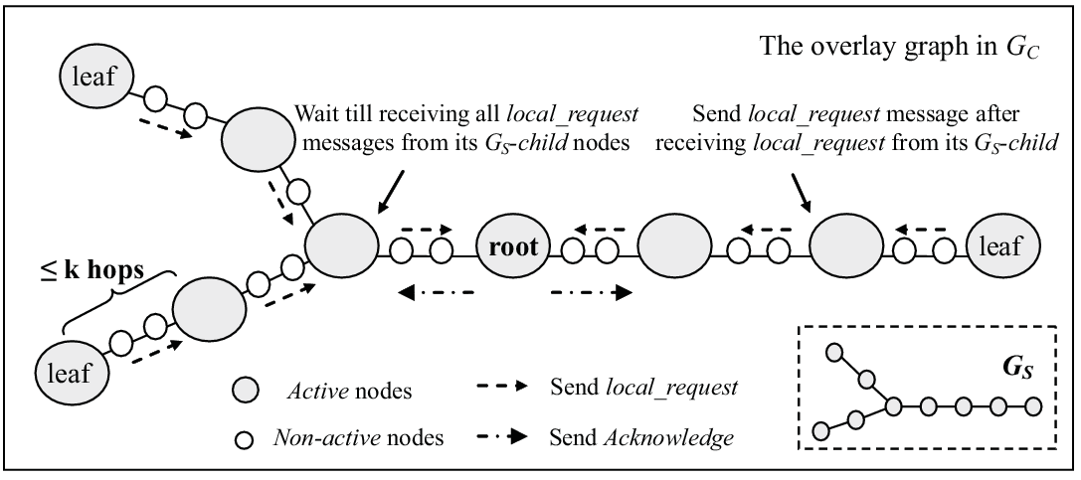
Basic Idea of LASEC
A-Ack mechanism
UIO decide on collaborating with another UIO only after obtaining some additional information from the collaboration candidate.
Specifically this information refers to ability of given UIO to compose another part of the service.

Slide 17
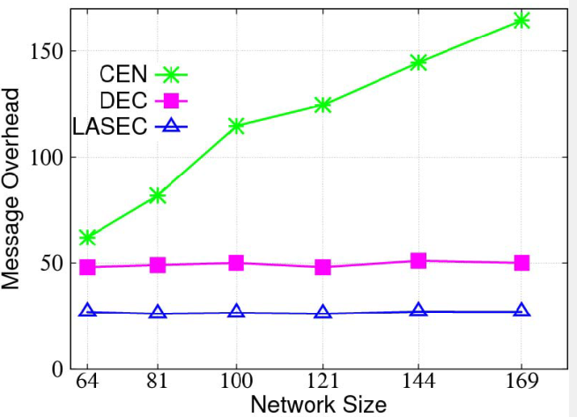
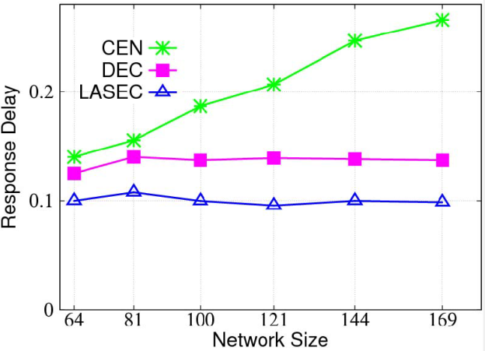
Simulation Results (1)
Scalability with regards to network size
Message overhead
Our LASEC service composition mechanisms require less messages than CEN for finding first result.
LASEC scales very well with the growing size of the network while CEN imposes larger cost when the network grows.
Response delay
LASEC algorithm performs better than DEC and CEN.
Similar as with message cost, LASEC and DEC scale better than CEN.

Slide 18
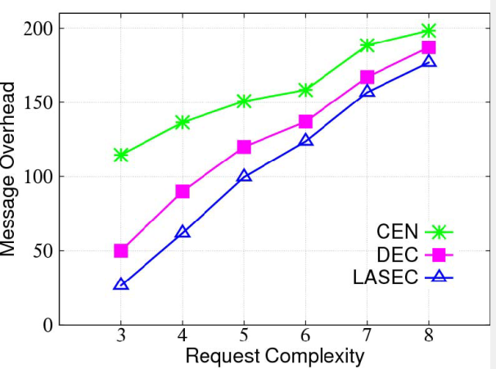
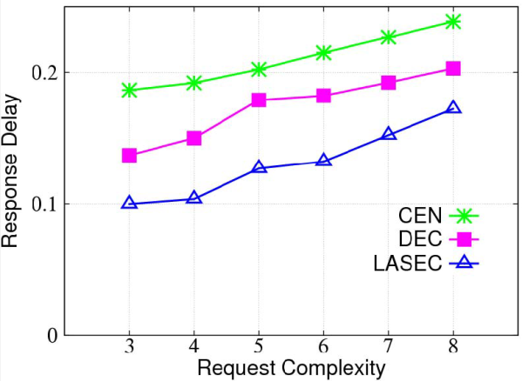
Simulation Results (2)
Scalability with regards to request complexity
Message overhead
Number of messages increases with the complexity of the request.
Along with the growth of request complexity, LASEC and DEC generate more messages, while CEN is more scalable.
Response delay
Our LASEC service composition mechanism performs better than DEC and CEN for finding first result.
Moreover, DEC, CEN and LASEC perform similar in terms of scalability.

Slide 19
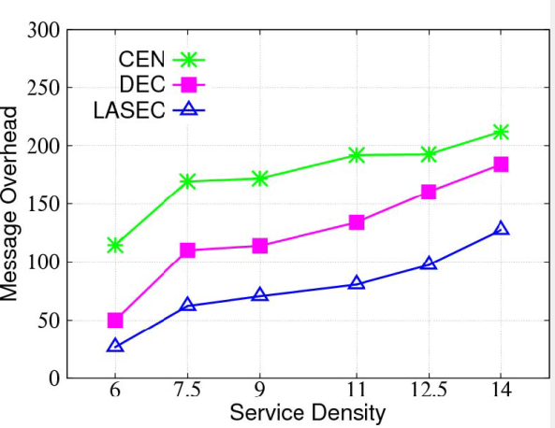
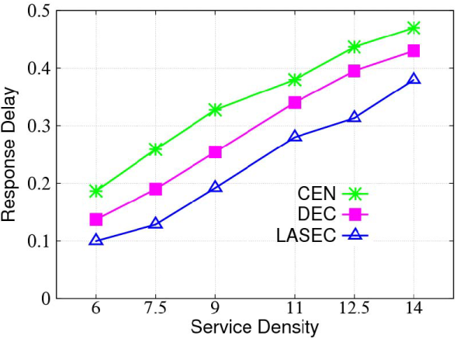
Simulation Results (3)
In these simulations we have explored localized characteristics of our approach and allowed nodes to forward message to 2 hop neighbours only.
We observe that response delay as well as number of messages increase with service density.
Our LASEC service composition mechanism has smaller overhead than DEC and CEN for finding the result

Slide 20
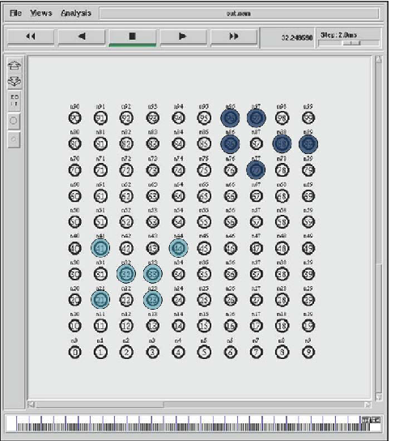
Simulation Results (4)
Composition locality - the distance between the services used in composition
LASEC tends to select compositions with high degree of composition locality

Slide 21
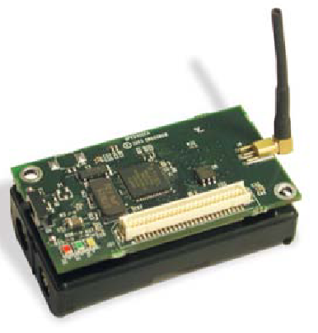
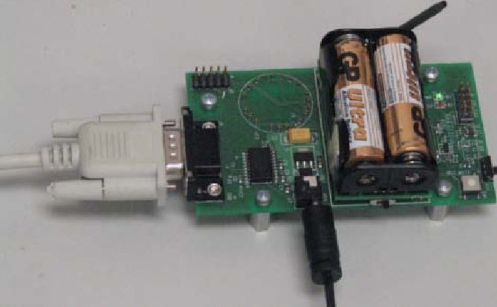
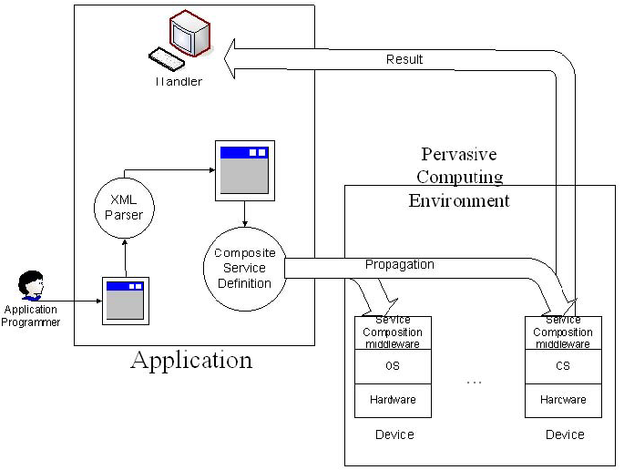
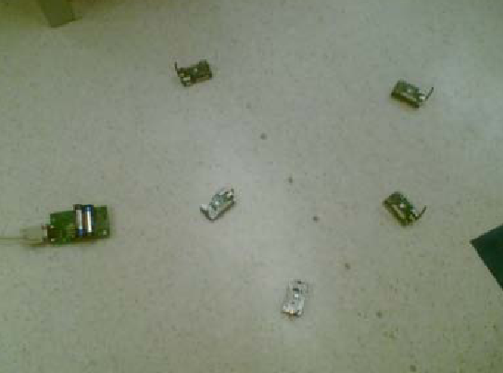
Experiment Results (1)
40 MicaZ nodes with a MIB600 gateway deployed in an indoor environment.

Slide 22
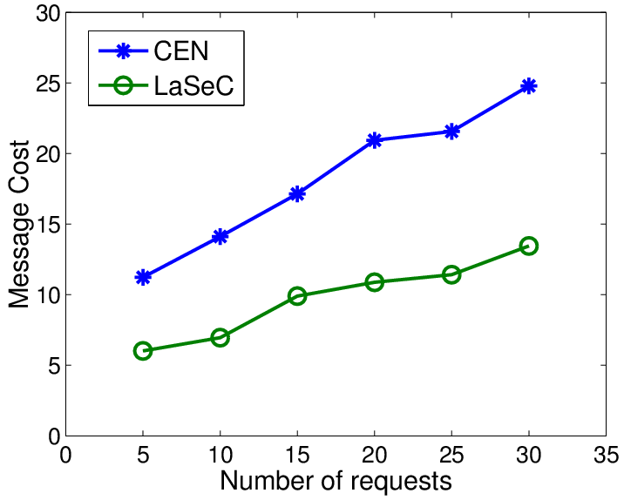
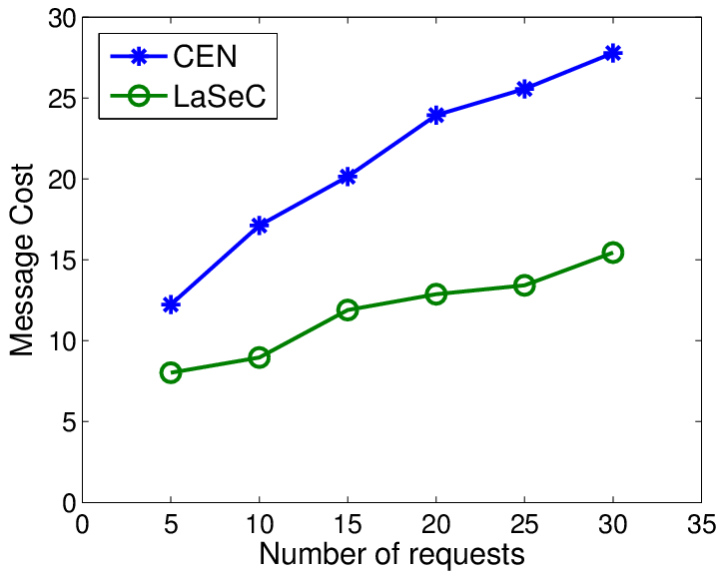
Experiment Results (2)
Message cost
LASEC can reduce the message cost by over 50 percent
LASEC scales better when the number of services increases
10
20

Slide 23
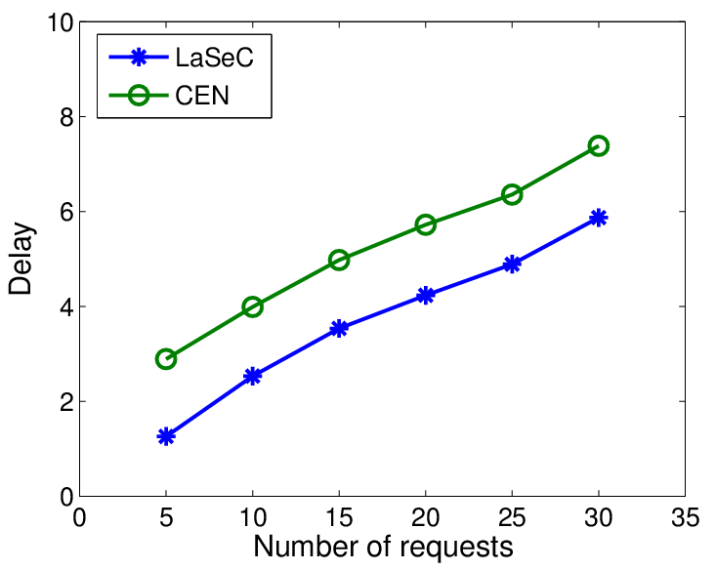
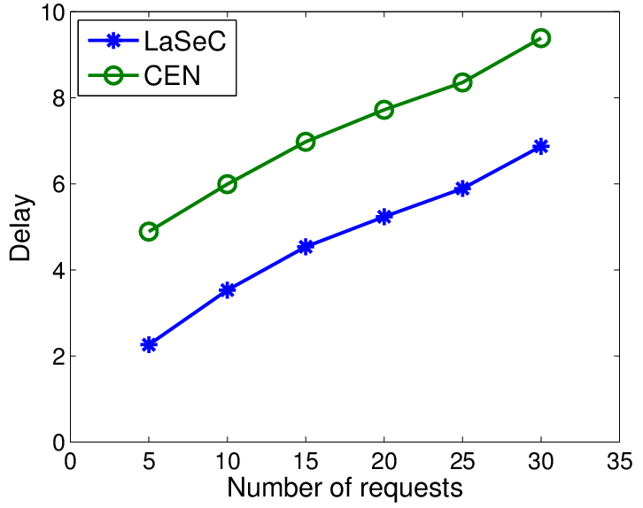
Experiment Results (3)
Message delay
LASEC achieves smaller delay, especially when there are more services in the environment.
10
20

Slide 24
Module 3 Summary
Service discovery
Service composition

Slide 25
Module 1-3 review

Slide 26

Open Question
Points: 10
What are the names of the three actors in web services architecture?
Open Question is only supported on Version 2.0 or newer.
Answer

Slide 27
Web Service Roles
Service
Registry
Service
Requestor
Service
Provider

Slide 28
Open Question
Points: 10
What is the purpose of web service protocol stack?
Open Question is only supported on Version 2.0 or newer.
Answer

Slide 29
Web Service Protocol Stack
Searching / Publishing Web Services
Discovery
UDDI
Description
WSDL
Describing Web Services interface
XML Messaging
XML-RPC, SOAP, Custom XML
Transport
HTTP, SMTP, FTP, BEEP
Encoding messages in XML format
Transporting XML messages between client and server

Slide 30
Open Question
Points: 10
How service requestor uses the protocols in web service protocol stack?
Open Question is only supported on Version 2.0 or newer.
Answer

Slide 31
Using the Protocols Together – service requestor perspective
Step 1:
Find Services via UDDI
Step 2:
Retrieve Service Description File:
WSDL or XML-RPC Instructions
Step 3:
Create XML-RPC or SOAP Client
Step 4:
Invoke Remote Service

Slide 32
Service requestor
Service
Registry
Discover Services
Retrieve Service
Description
Provider
Requestor
Service Description
Service
Invoke Remote
Service

Slide 33
Open Question
Points: 10
How service provider uses the protocols in web service protocol stack?
Open Question is only supported on Version 2.0 or newer.
Answer

Slide 34
Using the Protocols Together – service provider perspective
Step 1:
Create core functionality
Step 2:
Create an XML-RPC or SOAP service wrapper
Step 3:
Create WSDL service description
or XML-RPC integration instructions
Step 4:
Deploy service
Step 5:
Register new service via UDDI

Slide 35
Service Provider
Service
Registry
Register Services
Retrieve Service
Description
Service publisher
Customers
Service Description
Service
Invoke Remote
Service

